Slide 1

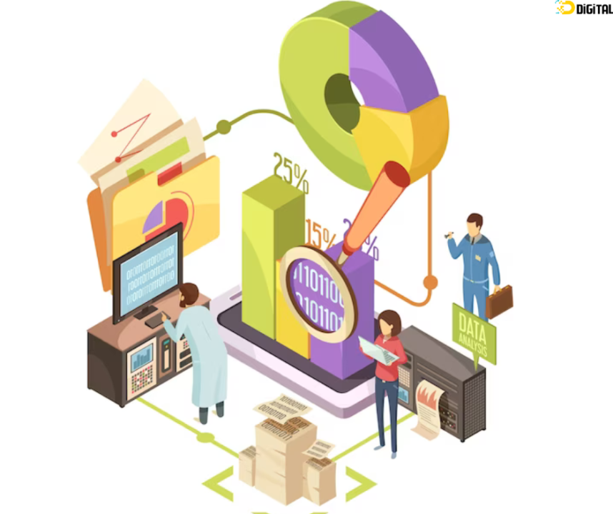
Capstone Final Project
Smart Search with Retail Analytics
Rajeev Sharma
Northwestern University
498 - Capstone
Mar-2024

Slide 2
Agenda
Problem Statement & Solution
Architecture
Tools and Technologies
Exploratory Data Analysis
Modeling Exploration and Analytical Dashboarding SW/SU

Slide 3
Problem Statement
Lack of context during search
Lack of personalization
Lack of Customer insights
Lack of understanding of customer intent

Slide 4
VirtuCart Overview
Search results based on free text
Mapping of search results to products available in the inventory.
Personalised search recommendations
Customer insights for E-commerce platforms

Slide 5
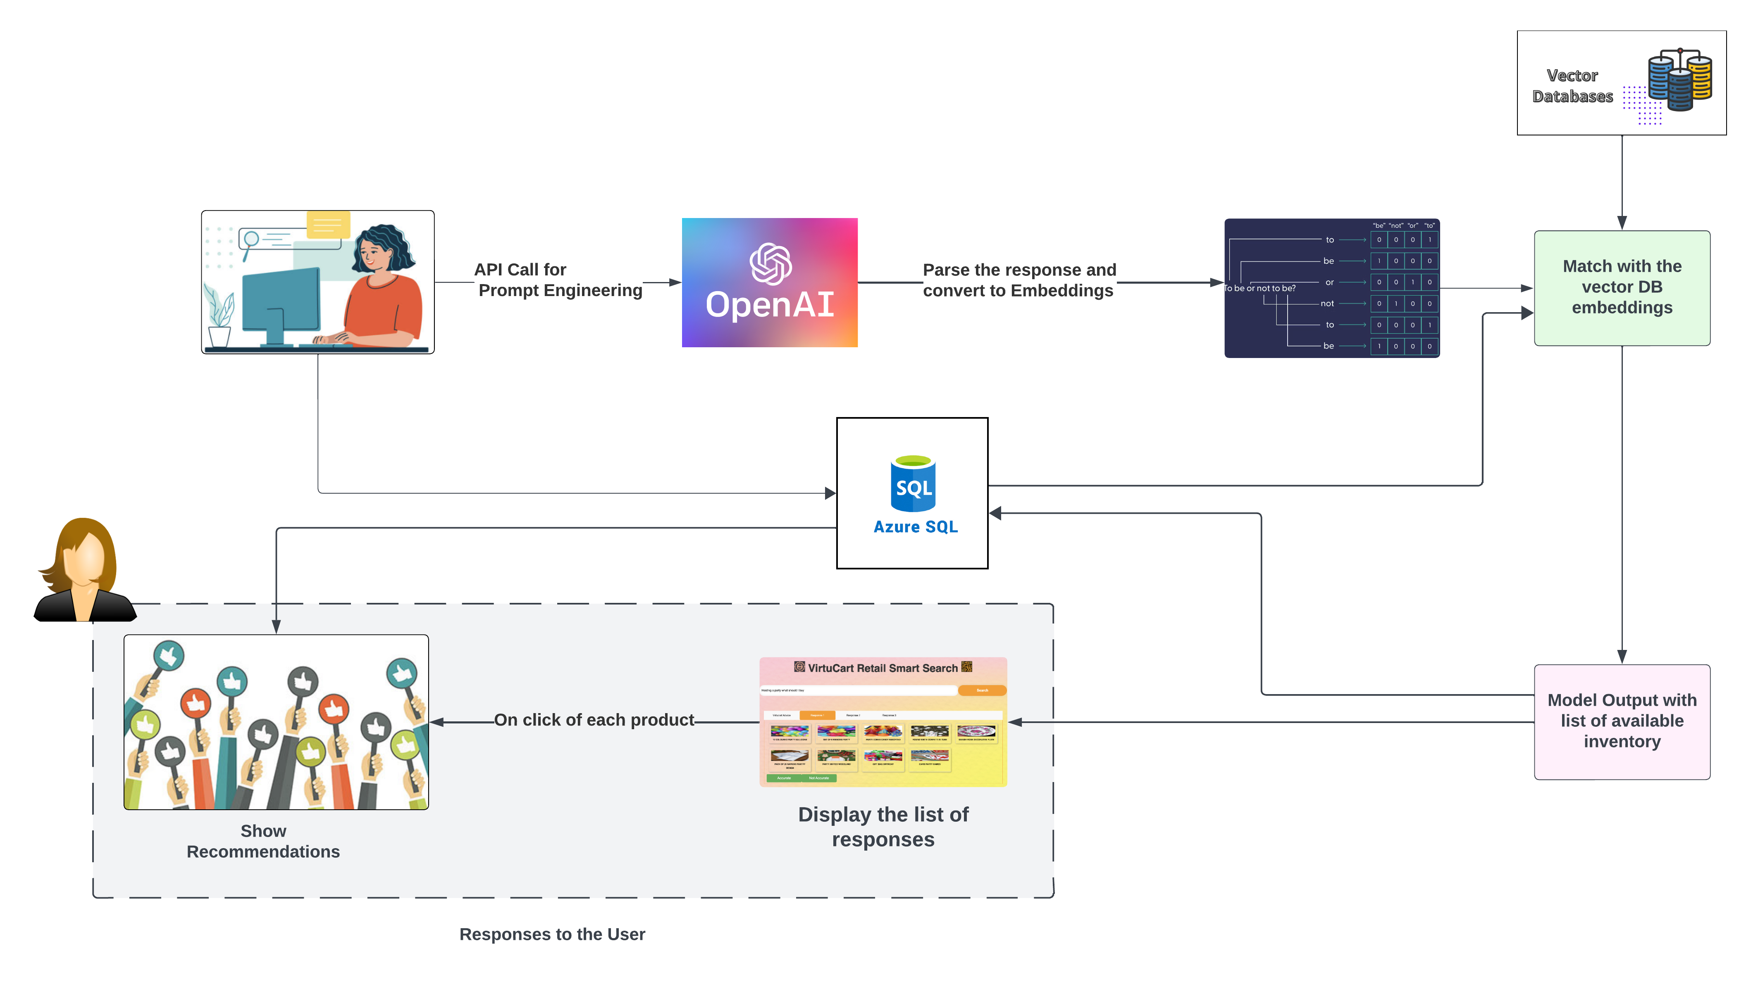
Architecture Diagram

Slide 6
Tools
Flask API
CI/CD pipeline with Github
Azure SQL
Azure AppService
Azure Blob Storage
Azure AI Search
MS PowerBI

Slide 7
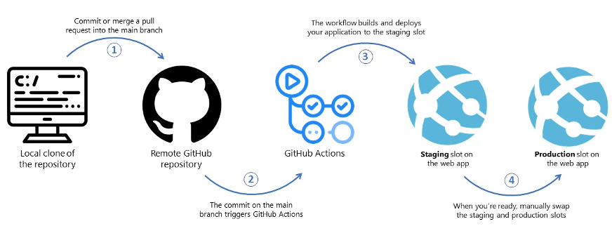
A Bird’s-Eye View of CI/CD Process
Image Source: Zero to Hero with App Service, Part 3: Releasing to Production - Azure App Service

Slide 8

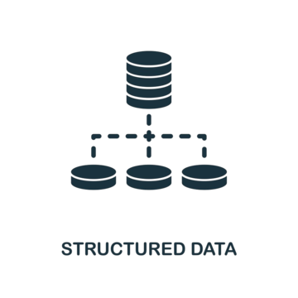
Working mechanism of Embeddings
Query Result
Query
Post Processing
Application
Embedding
Model
Object as Vector
[1.2,0.3,……,1.4]
Vector Database
Structured Text
Data Source

Slide 9
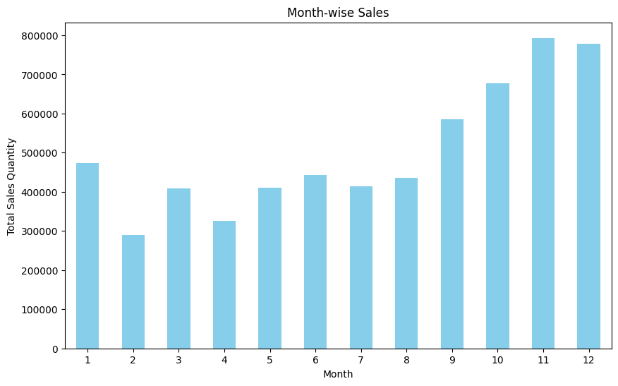
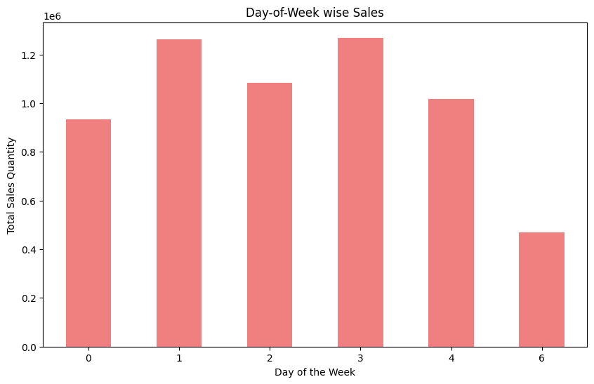
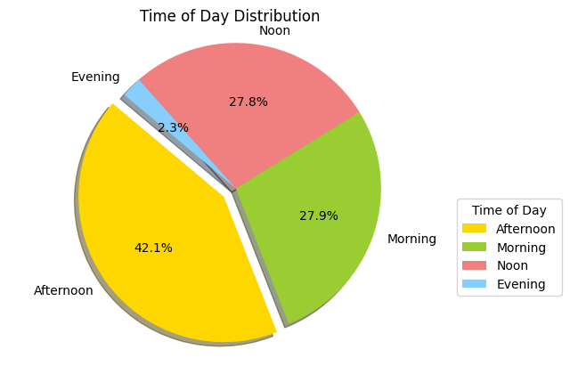
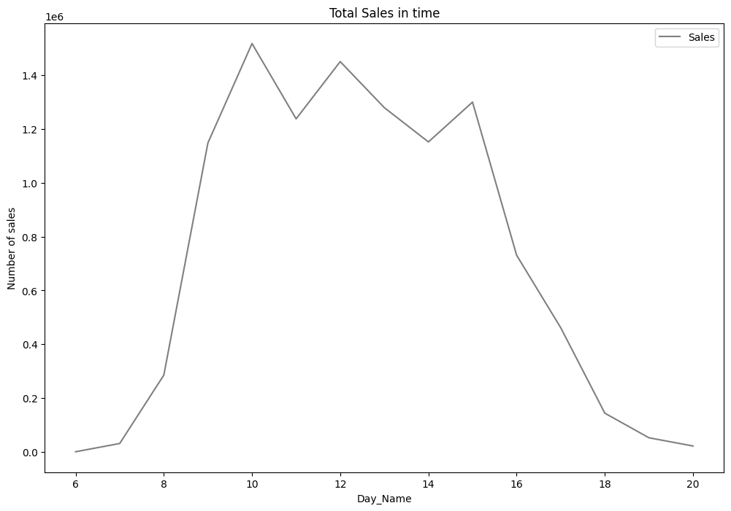
Exploratory Data Analysis

Slide 10
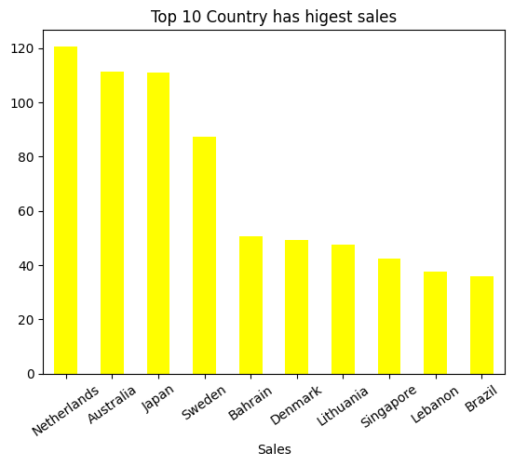
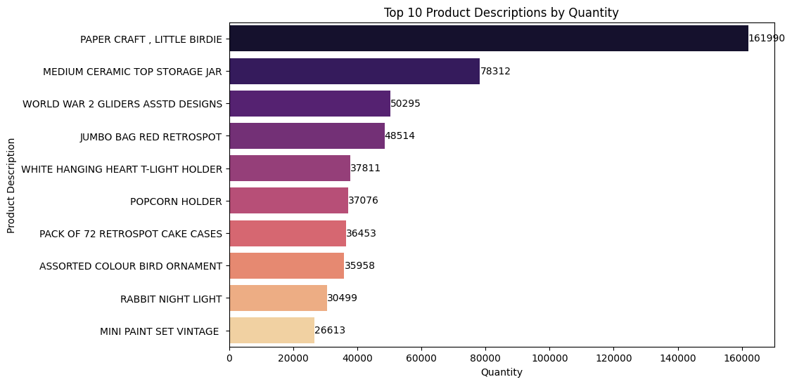
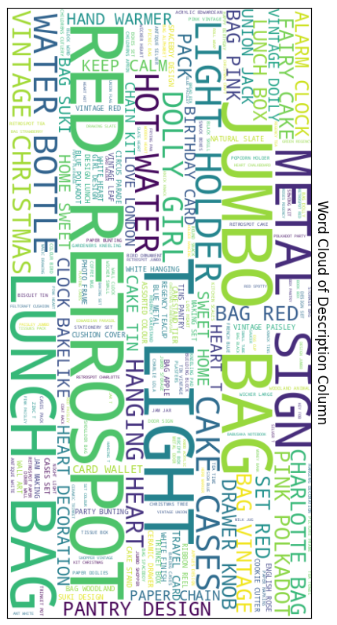
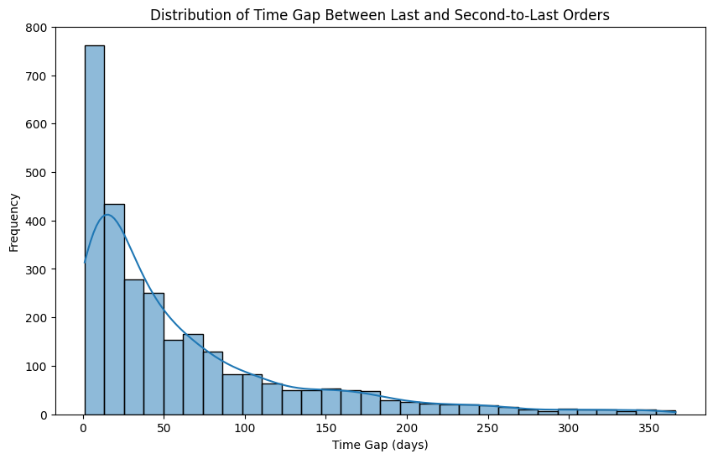
Exploratory Data Analysis

Slide 11
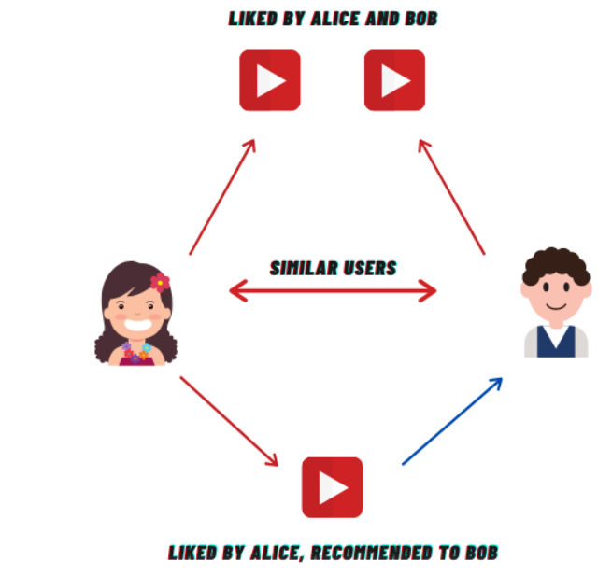
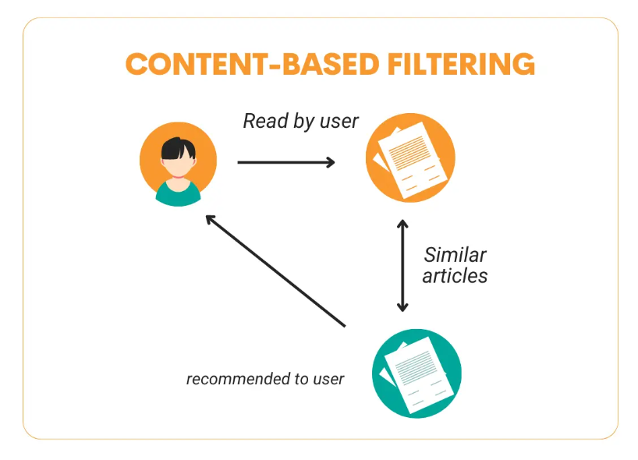
Recommendation Systems Types
Collaborative Filtering: A method that makes automatic
predictions about the interests of a user by collecting
preferences from many users (collaborating).
○ User-based
○ Item-based
Content-Based Filtering: A technique that recommends items
by comparing the content of the items and a user profile, with
content described in terms of several descriptors that are
inherent to the item
○ a book might be described by its author, its publisher, etc.
Hybrid Systems: A system that combines various
recommendation approaches to enhance prediction accuracy.
○ Netflix’s recommendation system, which uses a mix of
collaborative and content-based filtering.
Credit: Introduction to Collaborative Filtering-Analytics Vidhya
Credit: Step-by-Step Guide to Building
Content-Based Filtering - StrataScratch

Slide 12
Modelling Exploration
Part A : Customer
Part B: Retailer
Embedding Model
Recommendation Model
Customer Segmentation Model
Demand Forecasting Model
Customer Propensity Model
LLM: OpenAI

Slide 13
Evaluation of Embeddings Model
Text Cleaning
Vectorization
Get Similarity Score
Text cleaning involves removing noise like punctuation, stop words, and special characters. Tokenization splits text into words or phrases. Lemmatization reduces words to their base form, aiding analysis by standardizing vocabulary.
Text vectorization methods like Doc2Vec, Word2Vec, TF-IDF, and BERT convert text into numerical vectors, capturing semantic meaning. Each method differs in approach: Doc2Vec and Word2Vec learn word embeddings, TF-IDF weighs term importance, and BERT utilizes contextual embeddings.
Calculate similarity scores between test scenario documents by comparing their vector representations using methods like cosine similarity, aiding in assessing document relevance or similarity.

Slide 14
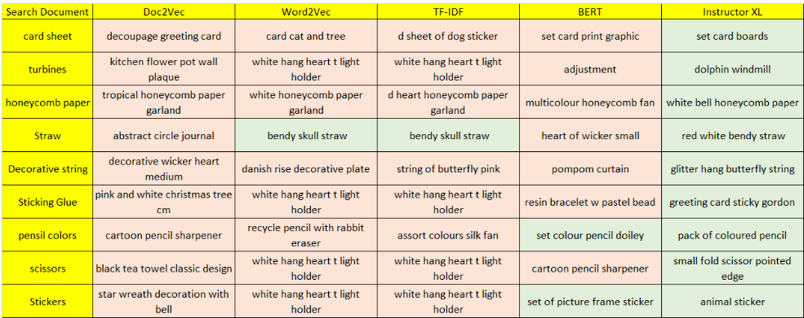
Exploration - Embedding Models
Instructor XL gave the right results for all test cases!

Slide 15
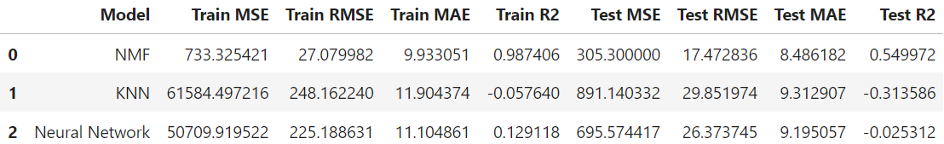
Recommendation Engine
Aspect | Recommendation Modeling | Collaborative Filtering
Input Data | Can include various features such as user behavior, item attributes, user demographics, etc. | Typically relies solely on user-item interactions (ratings, purchases, etc.)
Approach | Can include various techniques such as content-based filtering, collaborative filtering, matrix factorization, neural networks, etc. | Primarily relies on identifying similar users/items based on their interactions
Data Sparsity | Can handle sparse data effectively by leveraging additional features and metadata | May suffer from sparsity issues when users/items have few interactions
Cold Start Problem | Can handle cold start problem by leveraging item features or hybrid approaches | Typically faces challenges with cold start problem, especially for new users/items

Slide 16
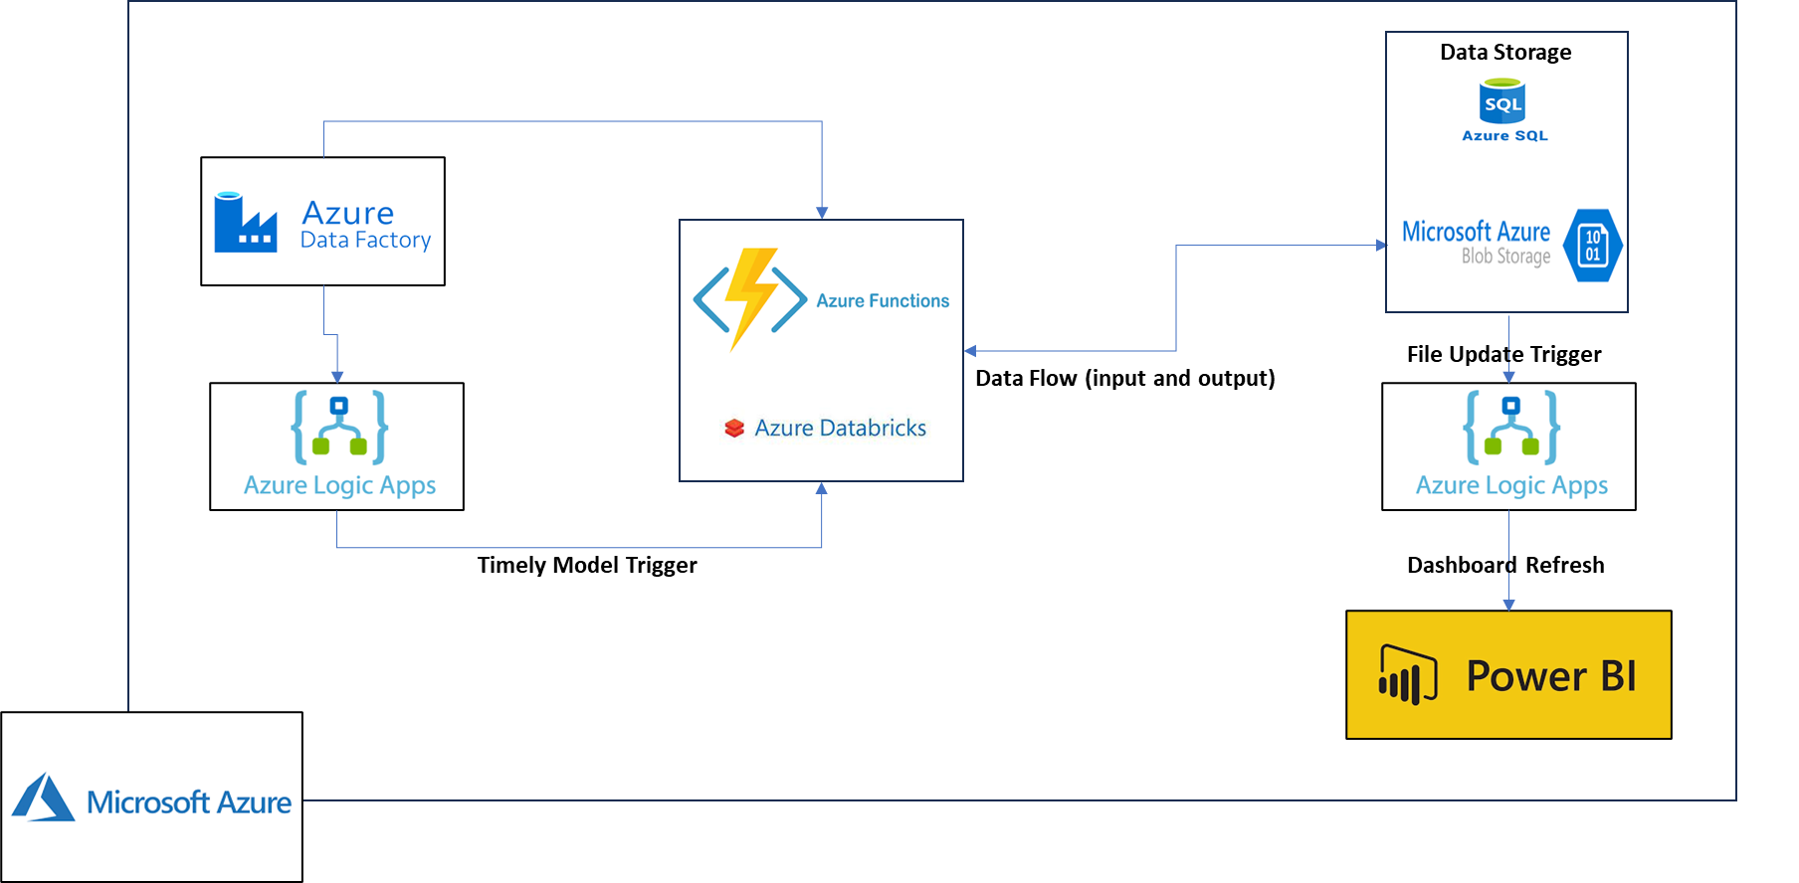
Retailer Dashboard : Architecture

Slide 17
CUSTOMER SEGMENTATION
Data Wrangling
Feature Engineering
Data Normalization
Model Selection
Cluster Analysis
Preprocessing raw data, missing value treatment, encoding categorical variables, and scaling features to prepare data for segmentation analysis.
RFM Feature creation
Recency: How recent a customer has made purchase..
Frequency: How frequent a customer makes purchase.
Monetary Value: Total revenue of customer purchase.
Normalization in K-means ensures features contribute equally to distance calculations, preventing bias from dominating features.
Elbow curve helps select optimal cluster number by identifying point where additional clusters offer diminishing returns in variance reduction.
Cluster analysis identifies groups of similar data points, aiding segmentation to understand customer behavior or patterns within datasets.

Slide 18
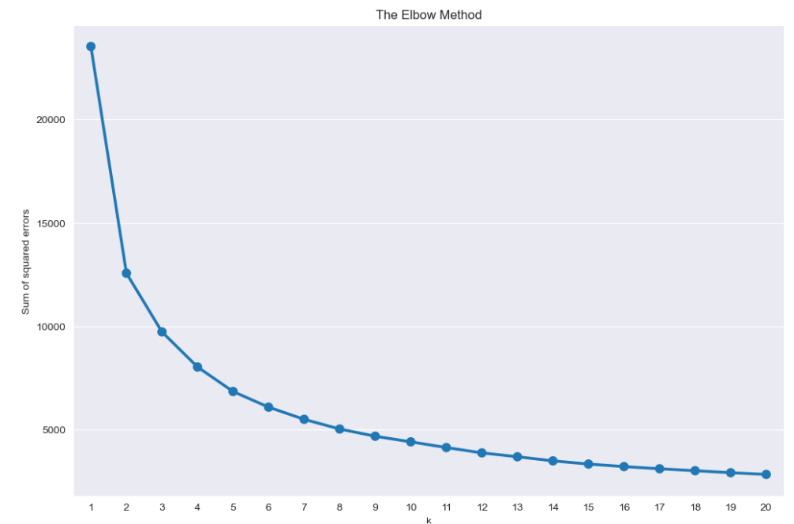
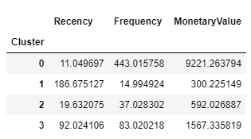
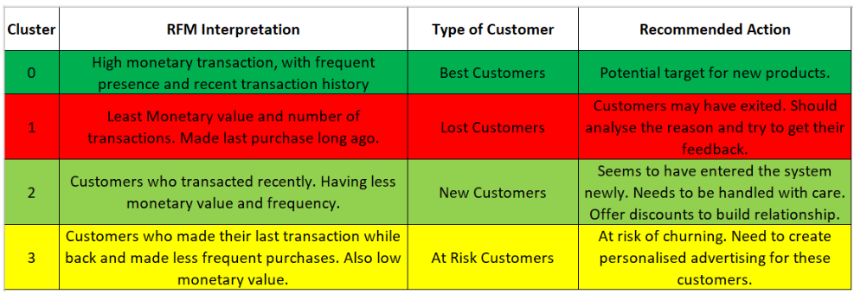
MODELING & CLUSTER ANALYSIS
4 Clusters

Slide 19
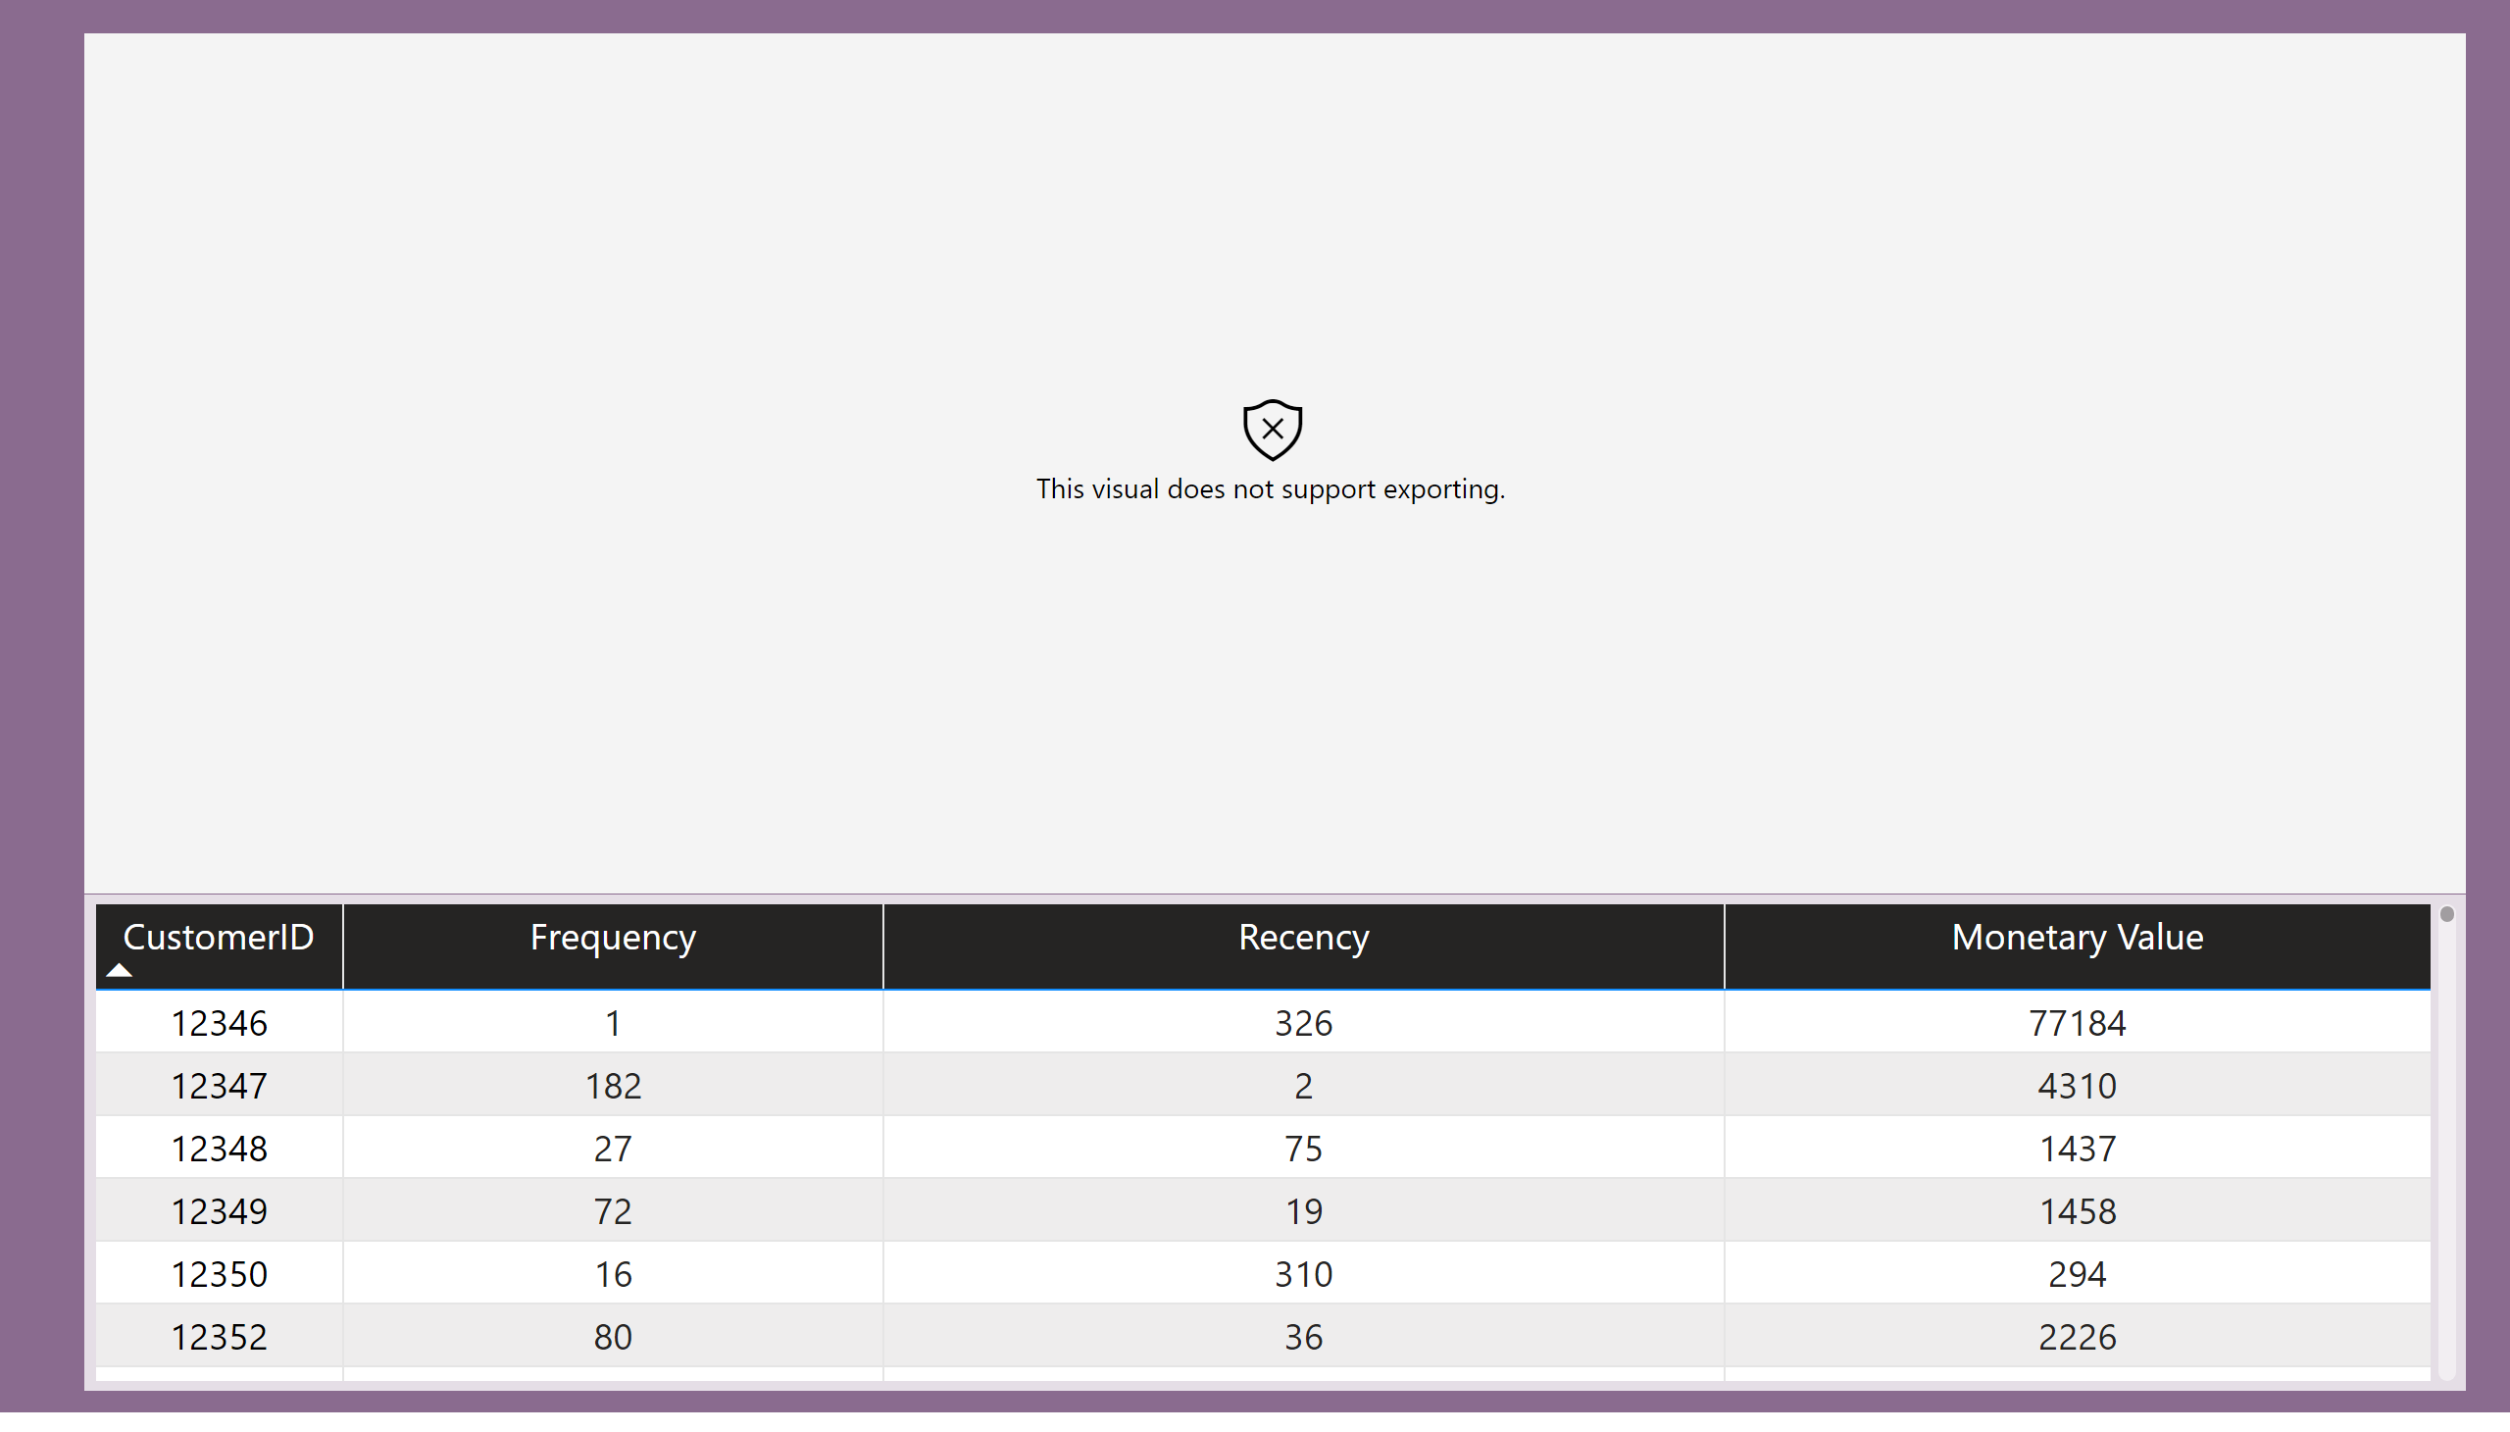
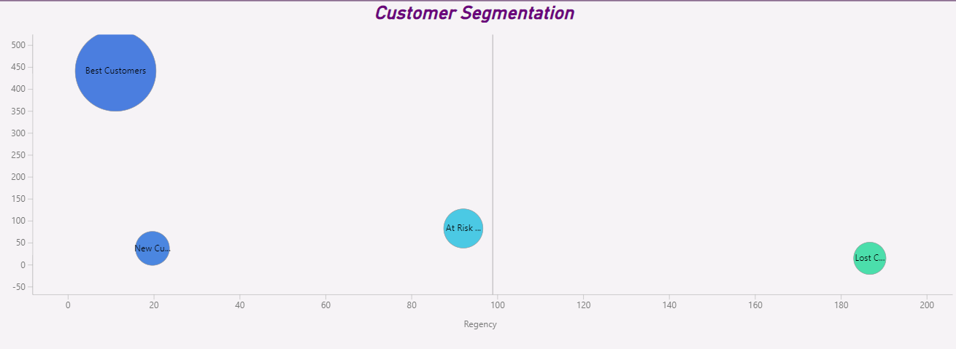

Slide 20
CUSTOMER PROPENSITY
Data Wrangling
Feature Engineering
Model Training
Model Selection
Customer Propensity Analysis
Preprocessing raw data, missing value treatment, encoding categorical variables, and scaling features to prepare data.
Include RFM features created for segmentation model.
Create monthly & weekly customer purchase indicator flag variables from historical data.
We have four different models:
Model 1: Predict purchase in next quarter.
Model 2: Predict purchase month in next quarter.
Model 3: Predict purchase in next month.
Model 4: Predict purchase week in next month.
Run multiple model iteration for each of the above model.
Evaluate AUC-ROC and precision-recall for four models predicting purchase behavior at different intervals (quarterly, monthly, weekly).
Hyperparameter tuning also explored.
Models predict customer purchases: quarterly, monthly, and weekly. Assessing propensity over different timeframes aids in tailored marketing strategies, enhancing customer engagement and optimizing revenue generation.

Slide 21
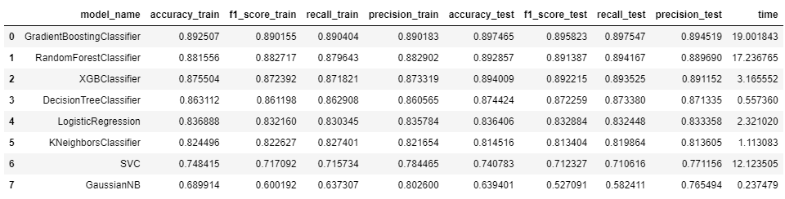
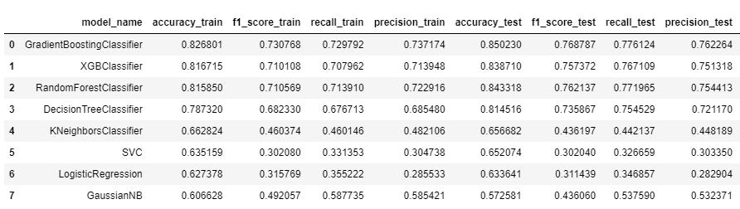
PROPENSITY MODELING & EVALUATION
Model 1: Predict purchase in next quarter.
Model 2: Predict purchase month in next quarter.

Slide 22
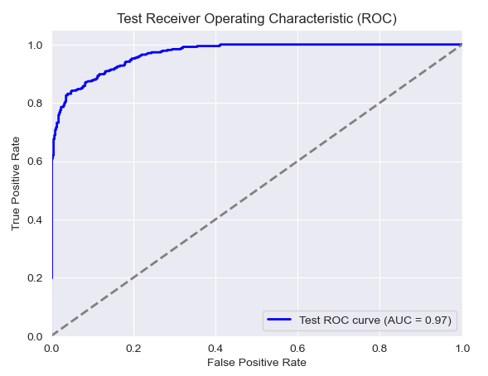
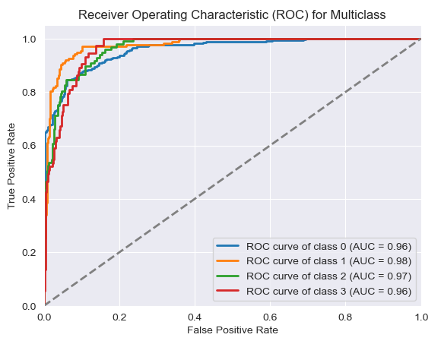
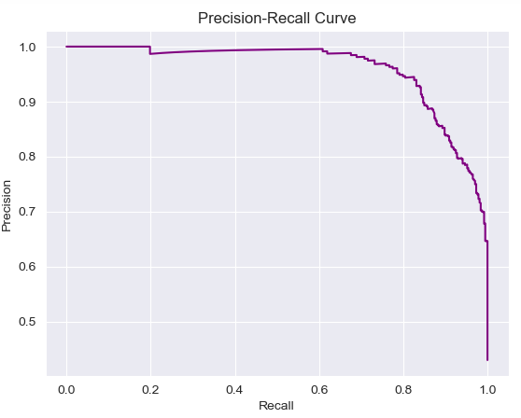
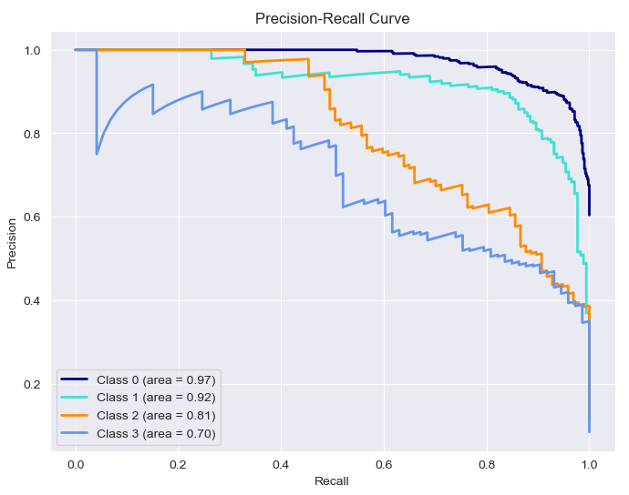
PROPENSITY MODELING & EVALUATION
Model 1: Predict purchase in next quarter.
Model 2: Predict purchase month in next quarter.

Slide 23
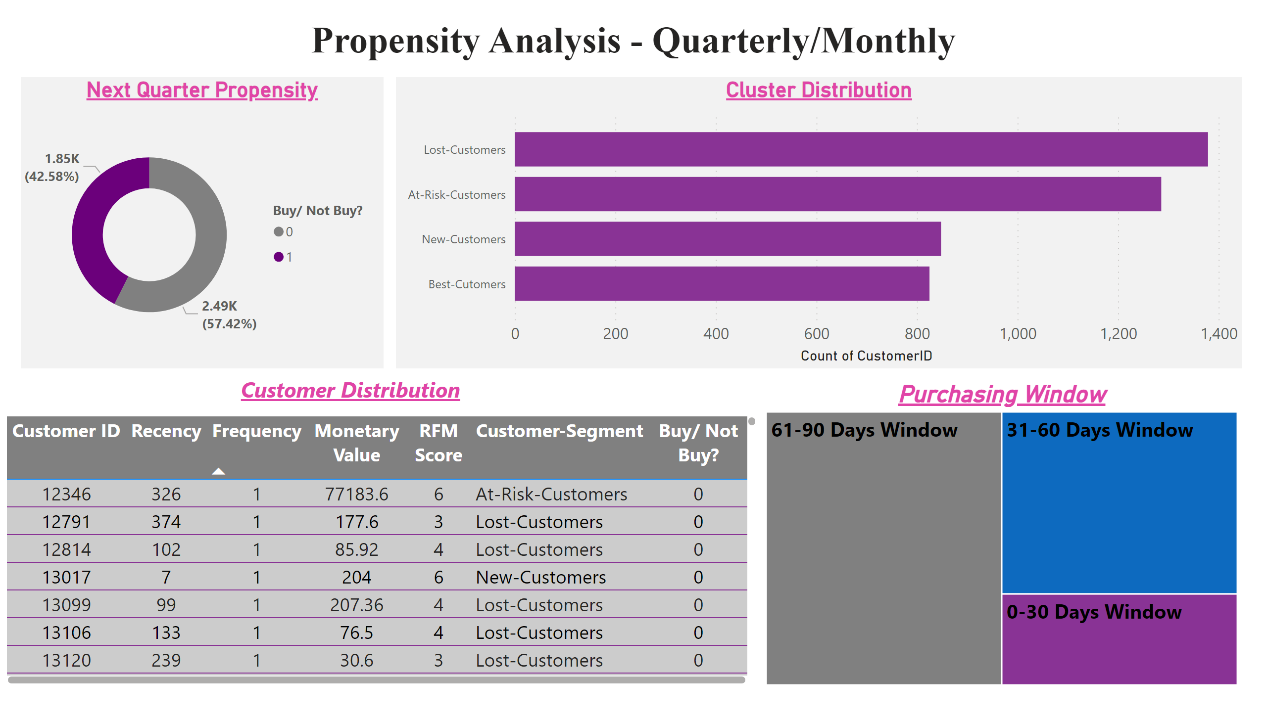
Propensity Quarter
Notes:
Next Quarter Propensity
No alt text provided
tableEx
No alt text provided
Purchasing Window
No alt text provided
Cluster Distribution
No alt text provided
textbox
No alt text provided
textbox
No alt text provided

Slide 24
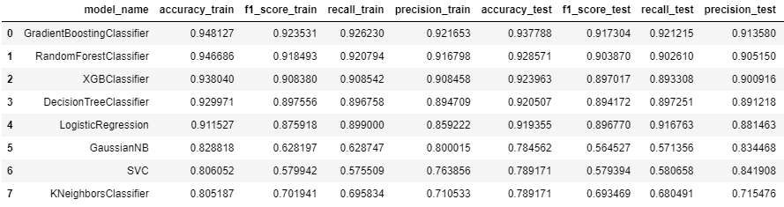
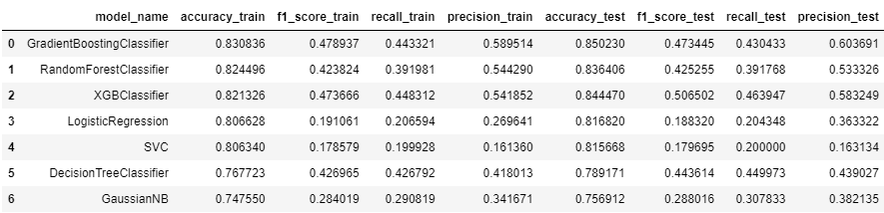
PROPENSITY MODELING & EVALUATION
Model 3: Predict purchase in next month.
Model 4: Predict purchase week in next month.

Slide 25
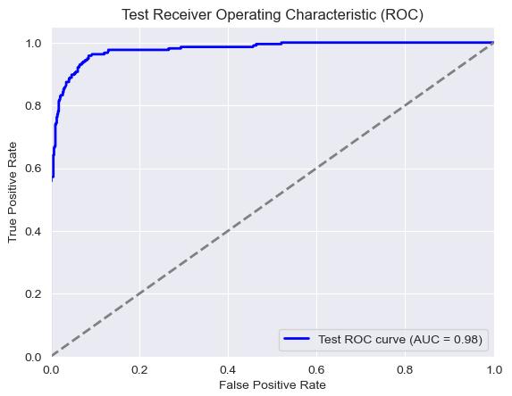
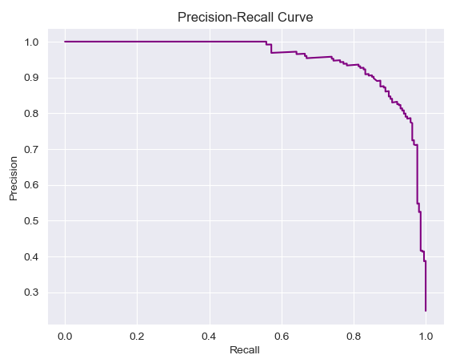
PROPENSITY MODELING & EVALUATION
Model 3: Predict purchase in next month.
Model 4: Predict purchase week in next month.

Slide 26
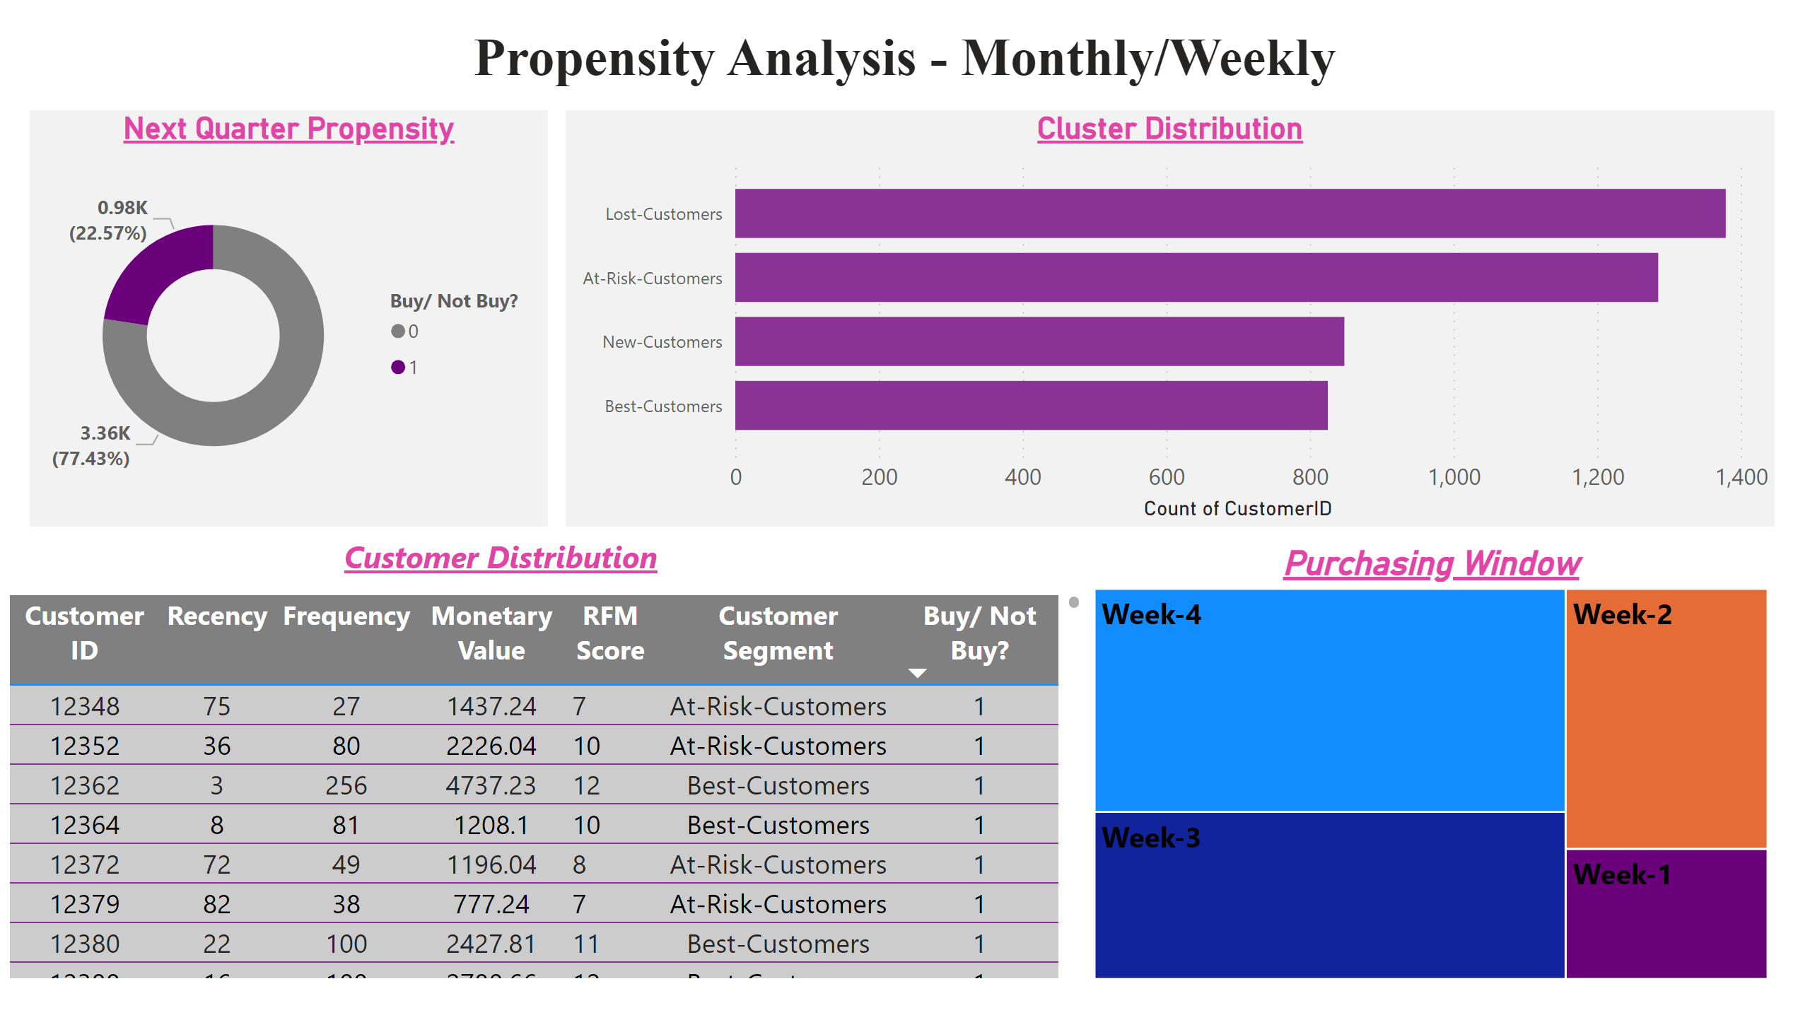
Propensity Month
Notes:
Next Quarter Propensity
No alt text provided
tableEx
No alt text provided
Purchasing Window
No alt text provided
Cluster Distribution
No alt text provided
textbox
No alt text provided
textbox
No alt text provided

Slide 27
Demand Forecasting Story
Data Wrangling
Feature Engineering
Model Training
Hyperparameter tuning
Model Selection
Aggregating Data Based on Month/ Week
Increase/ decrease over months
Statistical Parameters
ML based Models:
LR, DT, RF, GB, LightGBM
XGB, SVM, NN
Time Series Bases Models:
SARIMA (Weekly)
SARIMA (Monthy)
Different Matrices
R-Squared error, Mean Absolute Error,etc.
Time Series Bases Models:
ACF & PACF
Hyperparameters
N-entimators, learning_rate, max_depth, min_sample_split,min_samples_leaf
SARIMA model with Monthly data to Forecast Monthly Quantity

Slide 28
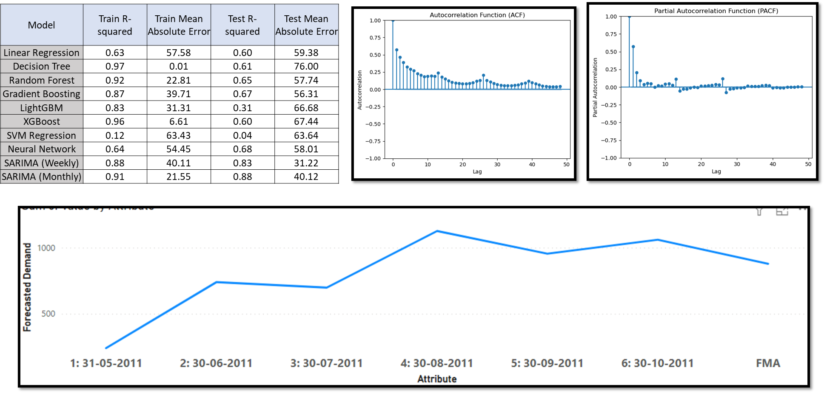
Demand Forecasting Story
Forecasted
Demand

Slide 29
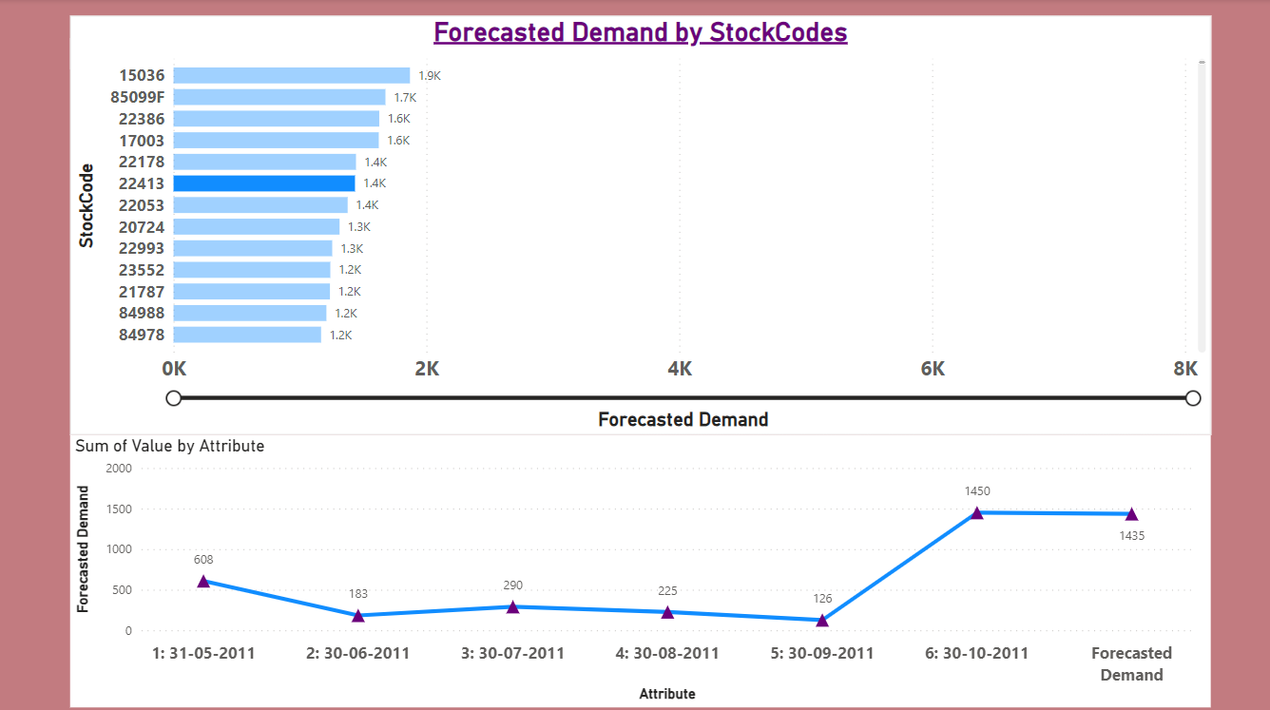
Forecasted
Demand

Slide 30
Plug & Play
Understand client’s product database.
Fine-tune prompt engineering as per client requirement.
Create embedding database using our embedding model infrastructure. (Explain the model used)
Adjust features for embeddings.
Eg: {‘name’:[],’desc’:[],’category’:[],’origin’:[]}
Create Recommendation database for each product based using content based and collaborative filtering.
Integration of advanced search GUI.
Automated data cleaning steps.
Automated model selection and integration with PowerBI pipeline.

Slide 31
Cluster 1: Integration Of Flask APIs And Cloud Deployment
Cluster 2: Creation Of PowerBI Dashboard And Analytics
Cluster 3: Creation Of GUI And Backend
Cluster 4: Embedding And Recommendation Engine
Cluster 5: Modeling Exploration

Slide 32
Thank You

